Slide 1

Database Processing: Fundamentals, Design, and Implementation
15th Edition
Week #12
Data Modeling with the Entity-Relationship Model

Slide 2
The Data Model
A data model is a plan or blueprint for a database design.
A data model is more generalized and abstract than a database design.
It is easier to change a data model then it is to change a database design, so it is the appropriate place to work through conceptual database problems.

Slide 3
Data Model = Conceptual Design
Books on systems analysis and design often identify three design stages:
Conceptual design (conceptual schema)
Logical design (logical schema)
Physical design (physical schema)
The data model we are discussing is equivalent to the conceptual design as defined in these books.

Slide 4
The Entity-Relationship (E-R) Model
The Entity-Relationship (E-R) model is a set of concepts and graphical symbols that can be used to create conceptual schemas.
Versions:
Original E-R model—by Peter Chen (1976)
Extended E-R model—later extensions to the Chen model included subtypes
Now referred to as the extended E-R model, which is used in this book when using the term E-R model

Slide 5
Entities
Something that can be readily identified and that users want to track:
Entity class—a collection of entities of a given type
Entity instance—the occurrence of a particular entity
There are usually many instances of an entity in an entity class.

Slide 6
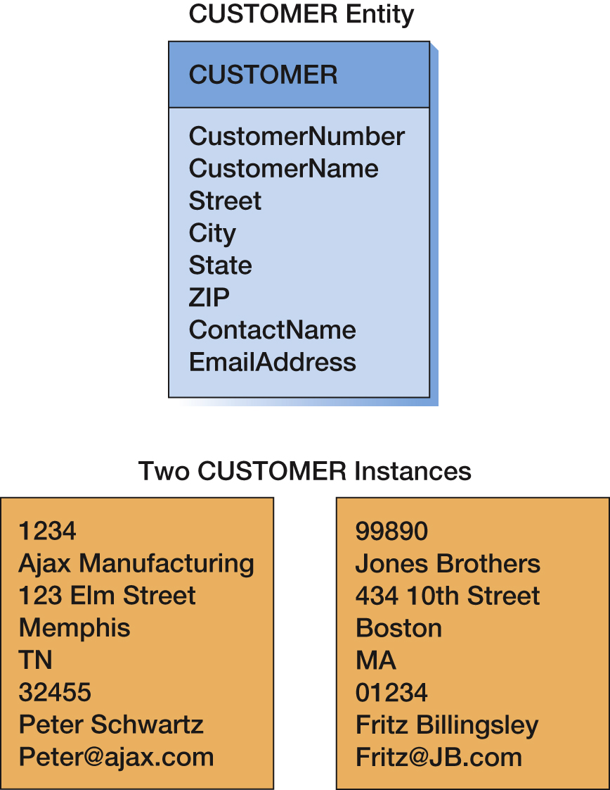
CUSTOMER Entity and Two Entity Instances

Slide 7
Attributes
Attributes describe an entity’s characteristics.
All entity instances of a given entity class have the same attributes, but vary in the values of those attributes.
They were originally shown in data models as ellipses.
Data modeling products today commonly show attributes in rectangular form.

Slide 8
Identifiers
Identifiers are attributes that name, or identify, entity instances.
The identifier of an entity instance consists of one or more of the entity’s attributes.
Composite identifiers are identifiers that consist of two or more attributes.
Identifiers in data models become keys in database designs.
Entities have identifiers.
Tables (or relations) have keys.

Slide 9
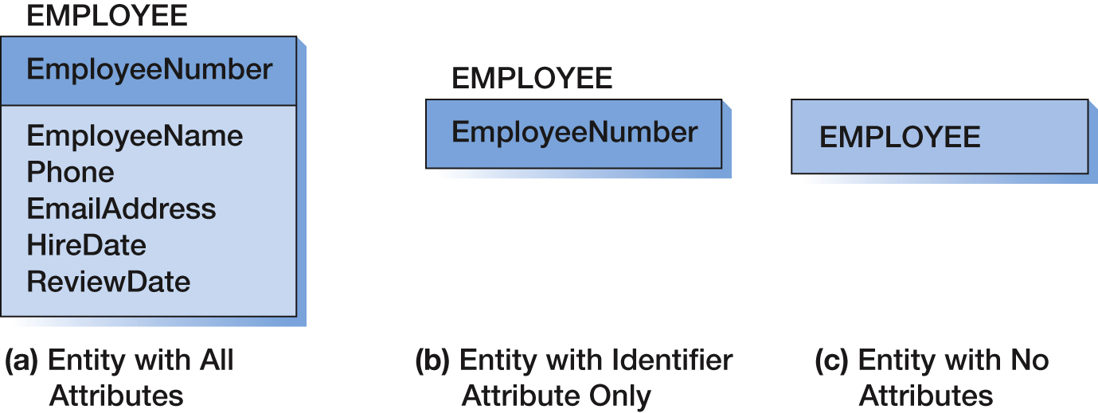
Entity Attribute Display in Data Models

Slide 10
Relationships
Entities can be associated with one another in relationships:
Relationship classes: associations among entity classes
Relationship instances: associations among entity instances
In the original E-R model, relationships could have attributes, but today this is no longer done.
A relationship class can involve two or more entity classes.

Slide 11
Degree of the Relationship
The degree of the relationship is the number of entity classes in the relationship:
Two entities have a binary relationship of degree two
Three entities have a ternary relationship of degree three

Slide 12
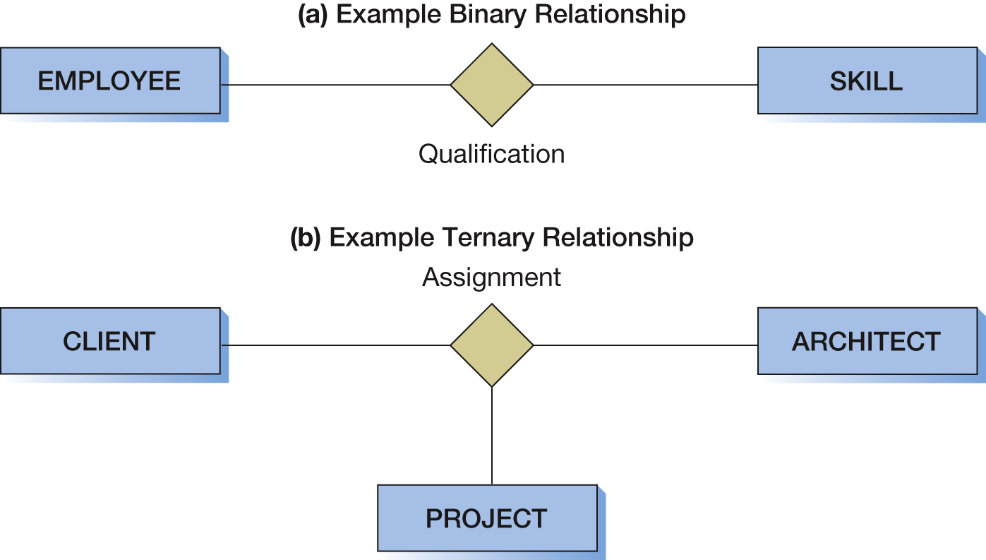
Binary Versus Ternary Relationships

Slide 13
Entities and Tables
The principle difference between an entity and a table (relation) is that you can express a relationship between entities without using foreign keys.
This makes it easier to work with entities in the early design process where the very existence of entities and the relationships between them is uncertain.

Slide 14
Cardinality
Cardinality means “count,” and is expressed as a number.
Maximum cardinality is the maximum number of relationship instances in which an entity can participate.
Minimum cardinality is the minimum number of relationship instances in which an entity must participate.

Slide 15
Maximum Cardinality
Maximum cardinality is the maximum number of relationship instances in which an entity can participate.
There are three types of maximum cardinality:
One-to-One [1:1]
One-to-Many [1:N]
Many-to-Many [N:M]

Slide 16
Minimum Cardinality
Minimum cardinality is the minimum number of entity instances that must participate in a relationship.
Minimums are generally stated as either zero or one:
IF zero [0] THEN participation in the relationship by the entity is optional, and no entity instance must participate in the relationship.
IF one [1] THEN participation in the relationship by the entity is mandatory, and at least one entity instance must participate in the relationship.

Slide 17
Parent and Child Entities
In a one-to-many relationship:
The entity on the one side of the relationship is called the parent entity or just the parent.
The entity on the many side of the relationship is called the child entity or just the child.
The relationships we have been discussing are known as HAS-A relationships:
Each entity instance has a relationship with another entity instance.
An EMPLOYEE has one or more COMPUTERs.
A COMPUTER has one assigned EMPLOYEE.

Slide 18
ID-Dependent Entities
An ID-dependent entity (a weak entity) is an entity (child) whose identifier includes the identifier of another entity (parent).
The ID-dependent entity is a logical extension or subunit of the parent:
BUILDING : APARTMENT
PAINTING : PRINT
The minimum cardinality from the ID-dependent entity to the parent is always one.

Slide 19
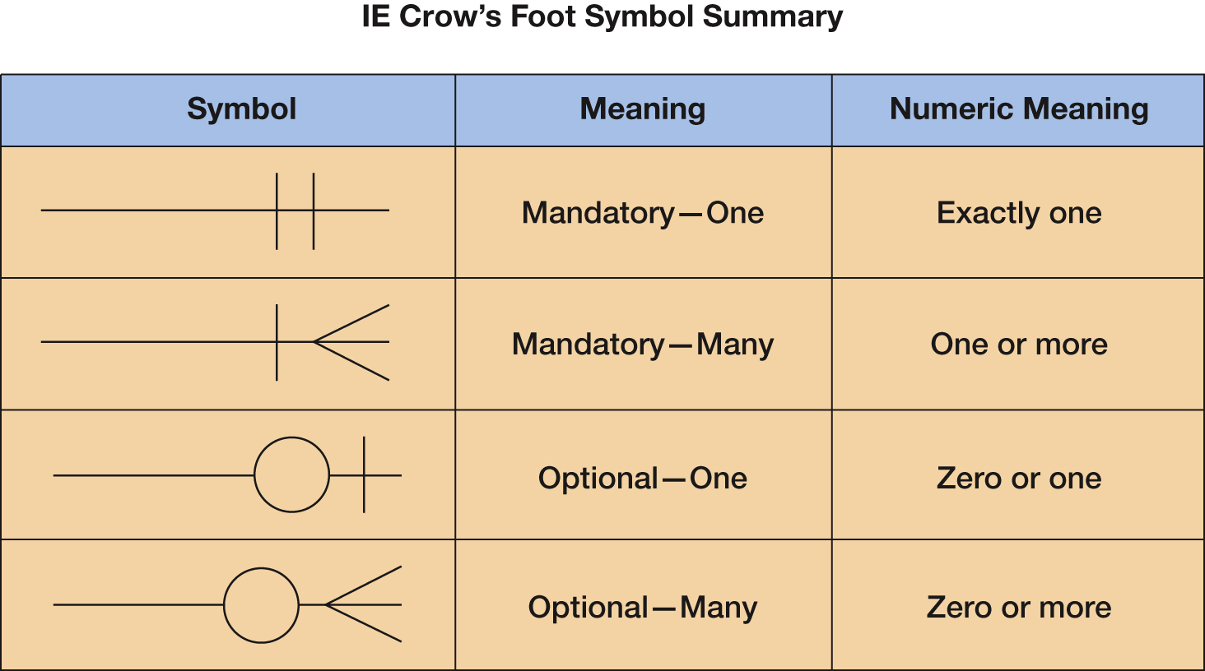
Crow’s Foot Notation

Slide 20
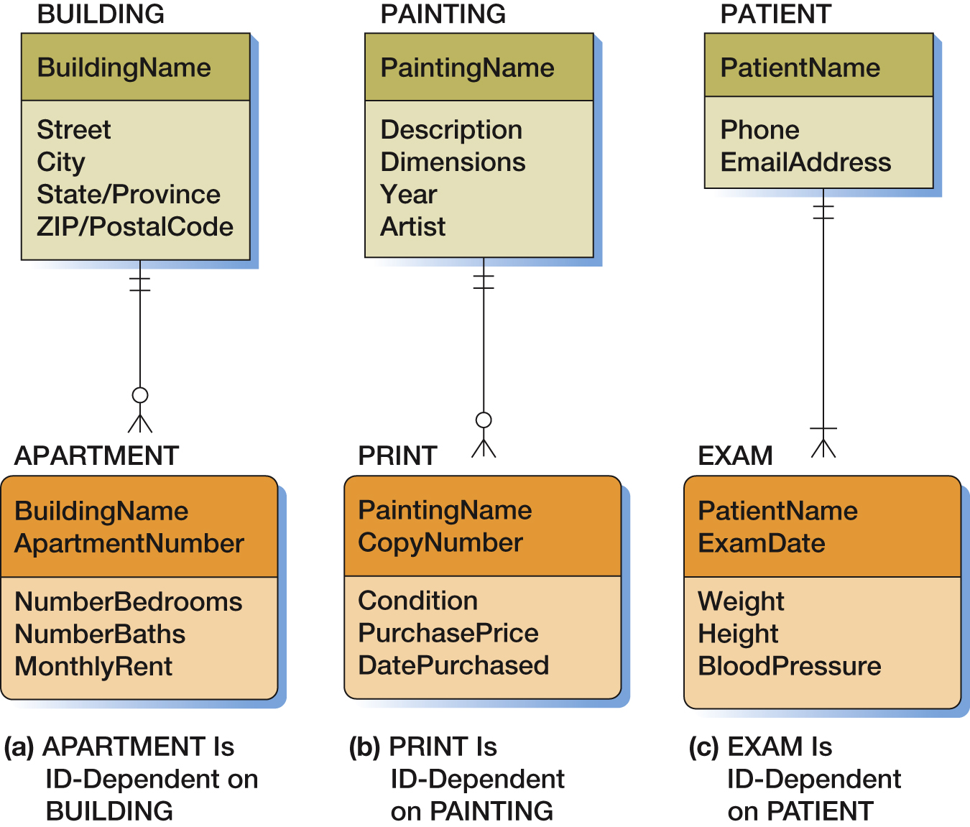
Examples of ID-Dependent Entities

Slide 21
Non-ID-Dependent Weak Entities
All ID-Dependent entities are considered weak.
There are also non-ID-dependent weak entities.
The identifier of the parent does not appear in the identifier of the weak child entity.

Slide 22
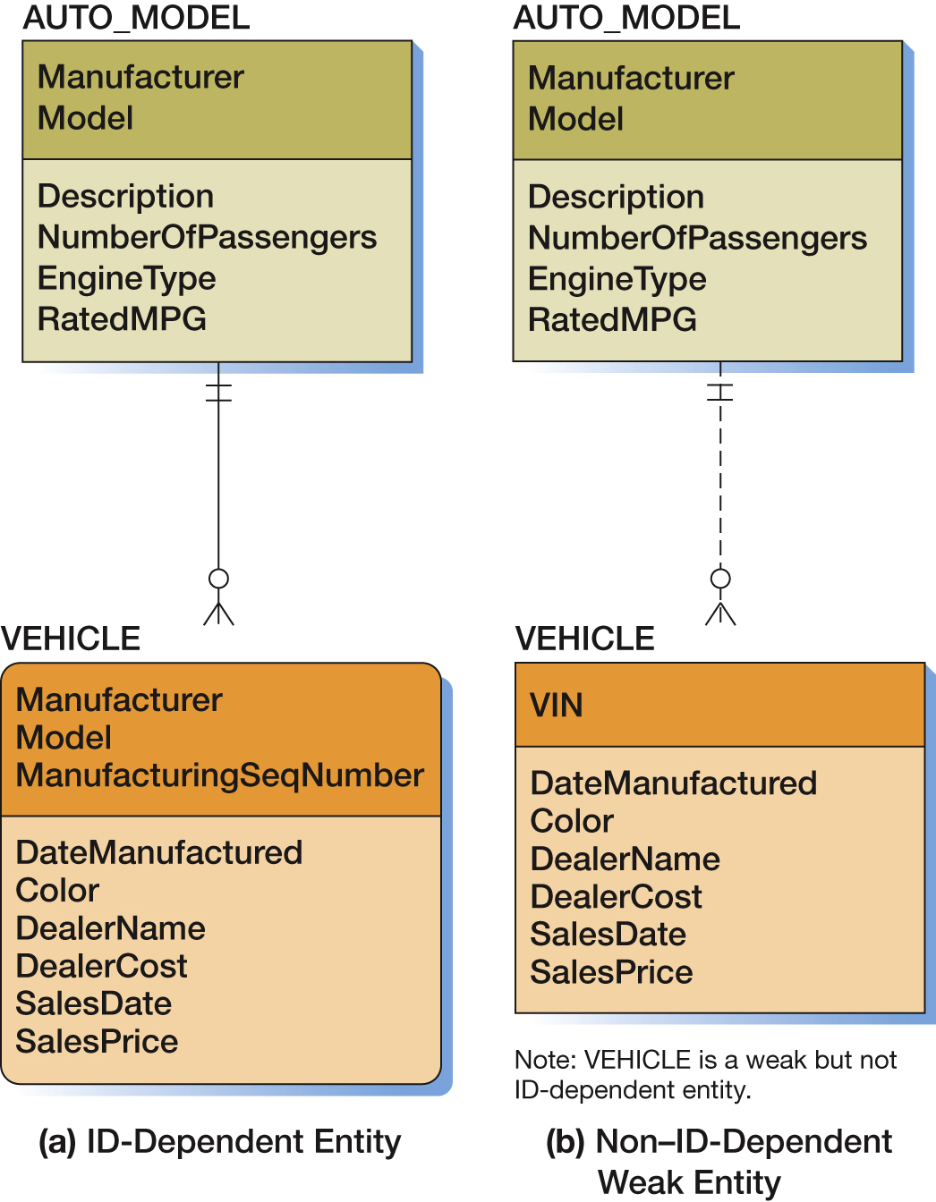
Example of a non-ID-Dependent Weak Entity

Slide 23
Subtype Entities
A subtype entity is a special case of a supertype entity:
STUDENT : UNDERGRADATE or GRADUATE
The supertype contains all common attributes, while the subtypes contain specific attributes.
The supertype may have a discriminator attribute which indicates the subtype.

Slide 24
Subtypes: Exclusive or Inclusive
If subtypes are exclusive, one supertype relates to at most one subtype.
If subtypes are inclusive, one supertype can relate to one or more subtypes.

Slide 25
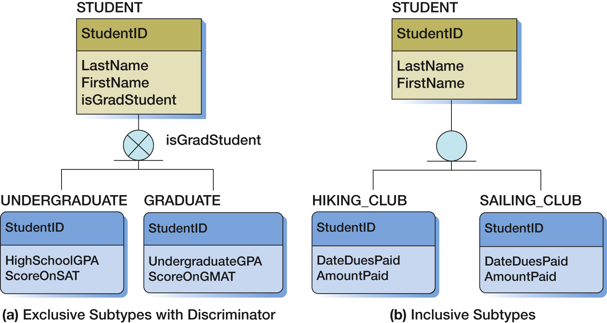
Examples of Subtype Entities

Slide 26
Strong Entity Relationship Patterns
Three basic relationship types are possible between two strong entities:
1:1 Strong Entity Relationship
1:N Strong Entity Relationship
N:M Strong Entity Relationship
These are addressed on the following slides.

Slide 27
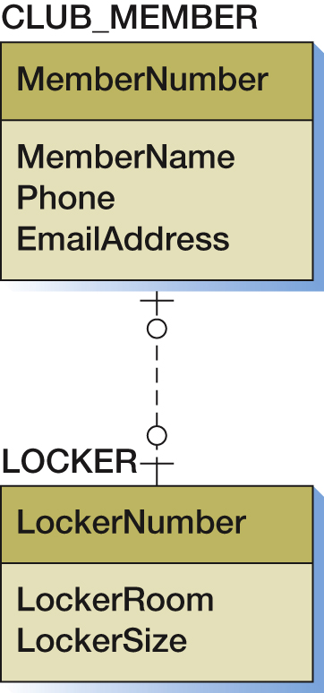
Data Model for the 1:1 Strong Relationship

Slide 28
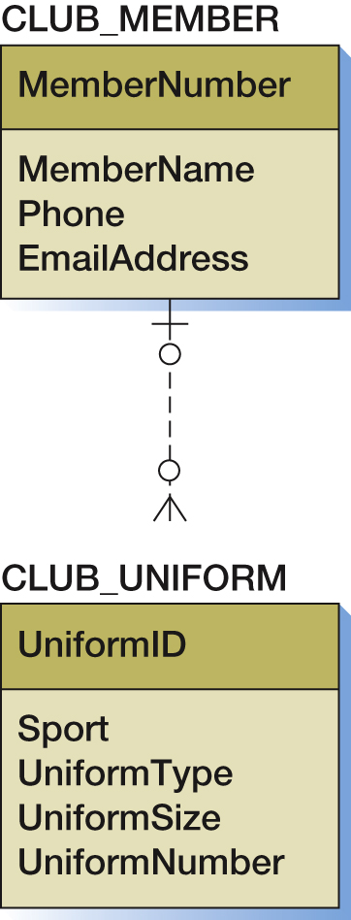
Data Model for the 1:M Strong Relationship

Slide 29
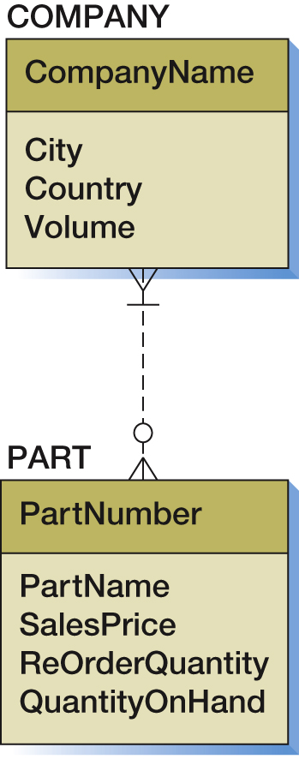
Data Model for the N:M Strong Relationship

Slide 30
Database Processing Fundamentals, Design, and Implementation (15th Edition)
End of Presentation:
Week #12

